Slide 1
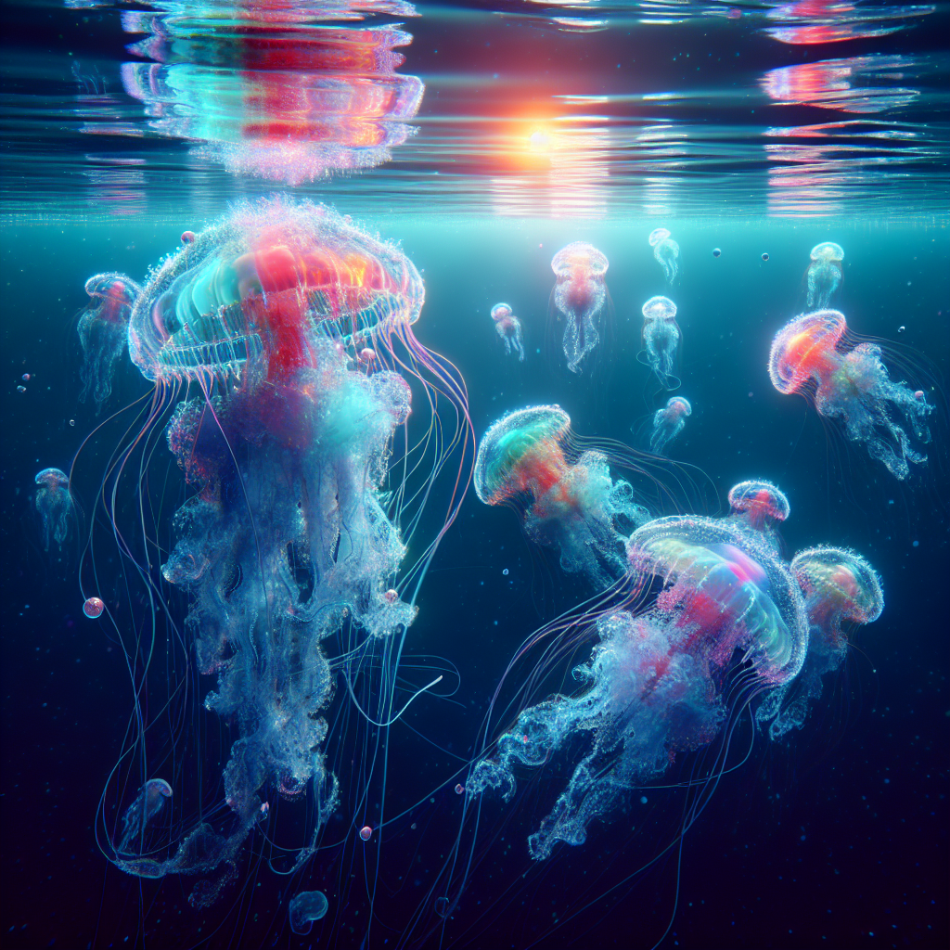
"Exploring the Fascinating World of Jellyfish: Characteristics, Varieties, and Unique Life Cycle"
• Jellyfish: Also known as medusas or sea jellies
• Habitat: Inhabit the world's oceans
• Classification: Belong to the phylum Cnidaria
• Physical Characteristics: Gelatinous bodies and tentacles
• Variety: Range of shapes, sizes, and colors- from small and transparent to large and vibrant
• Unique Life Cycle: Starts as polyp attached to ocean floor, transforms into a free-swimming medusa

Slide 2
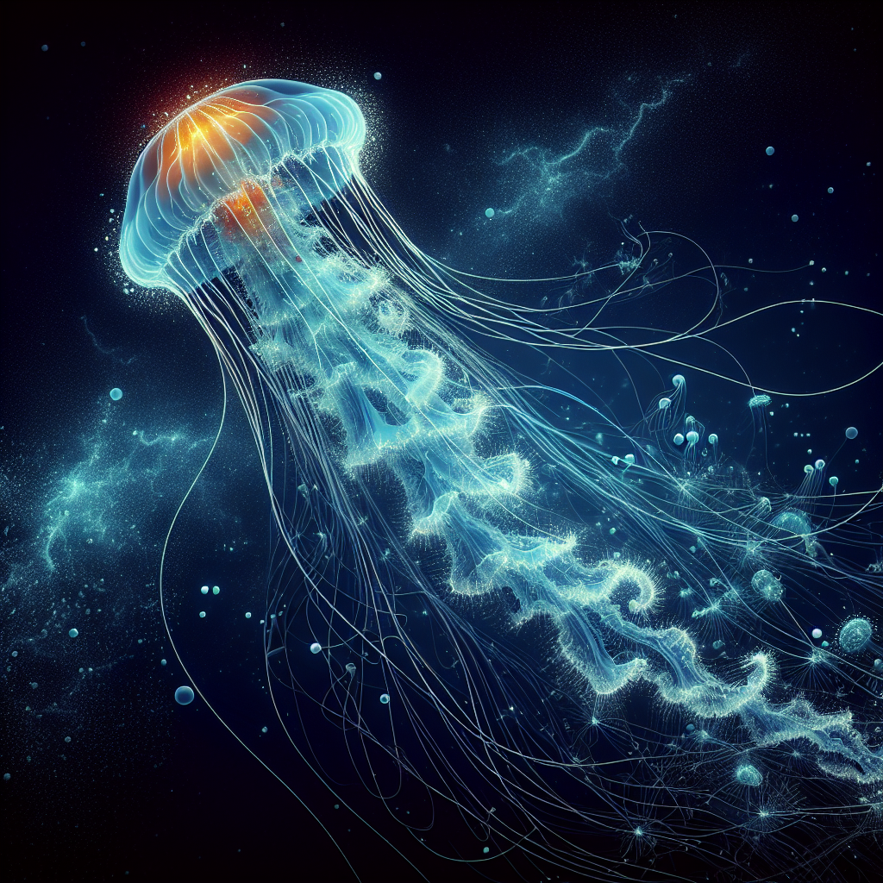
"Jellyfish: Understanding their Unique Stinging Mechanism and its Effects on Humans"
- Intriguing Aspects of Jellyfish: Ability to Sting
- Possess Specialized Cells: Cnidoctes
- Cnidoctes Contain Nematocysts: Deliver Venomous Toxins
- Function of Stinging Cells: Capture Prey & Defend from Predators
- Jellyfish Stings on Humans: Mostly Harmless, Some Can Be Dangerous
- Advice: Exercise Caution When Swimming in Jellyfish-Infested Waters

Slide 3
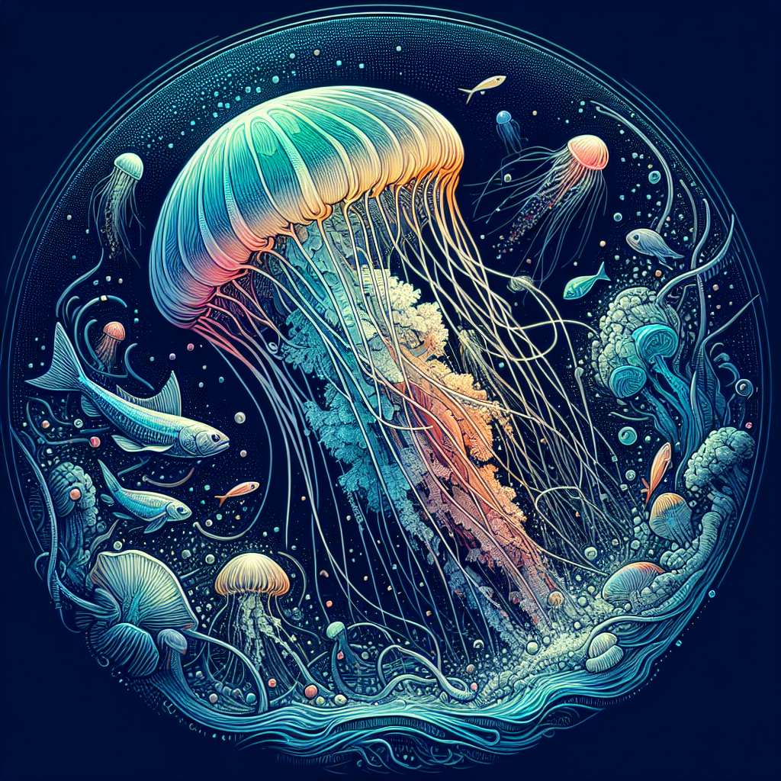
"Jellyfish: Crucial Contributors to Marine Ecosystems and their Adaptive Abilities"
• Jellyfish have vital roles in marine ecosystems
• Function as opportunistic feeders: consume planktonic organisms, fish eggs, and other jellyfish
• Act as predators to maintain marine food web balance
• Possess unique adaptability to changing environmental conditions

